Slide 1
Devops Docker Workshop
What is Docker? Why you might be using it wrong & how to get the most out of your containers.

Slide 2
Let’s talk Docker…
Notes:
Who knows what docker is? Would anyone like to hazard a guess?

Slide 3

Notes:
well yes, but actually no
So that was a bit of a trick question because the obvious answer would be that docker is seen as a containerised runtime to host an application. but its not the only name in the game for containers, I could for instance build a container using podman or buildkit, LXC or RKT, singularity, kaniko or Makisu. If you want to get fruity you can even build windows containers or use Hyper-V if the mood takes you, i wouldn't personally but nearly 20 years as an open source engineer makes you wary of such things.
Docker is in fact a container engine which runs as a daemon on a host machine.
Its also the most widely known and used method or software for building images, its therefore the most compatible, docker images will run on pretty much any container engine so even if you are not running the docker engine (which to be honest we rarely do in a production environment) you will likely build out your images using docker.
Lets take a quick look at containers at this point before we delve too deeply into Docker itself, for this i'm going to give you a bit of a history lesson on the evolution of server architecture and the economics involved in how we got to containers, i promise this will be at least semi interesting.

Slide 4
Let’s talk server architecture
Applications
Applications
Applications
Runtimes/Libraries
Runtimes/Libraries
Guest OS
Guest OS
Runtimes & Libraries
Virtual Hardware
Virtual Hardware
OS
Hypervisor
Hardware
Hardware
Notes:
Now once upon a time everything ran on physical servers, if you wanted a new webserver then you had to get someone to go connect an actual box into your comms room or if you were lucky enough and had the budget, your data centre, these servers were just a bit more powerful than your desktop machines (sometimes they were just repurposed desktop machines to be honest) it took time to get a new server in place and a hardware failure could mean a weekends worth of work to get it back up, in the cattle vs pets analogy these were the consummate pets, you gave it a name (usually gandalf or one of the hobbits, i went with jupiters moons in case anyone was wondering)
Are we all familiar with Moore's Law?
Moore's Law states that the number of transistors on a microchip doubles about every two years, though the cost of computers is halved - this was an observation in 1965 by Gordon Moore co-founder of intel
Moore's Law in this case affected our servers in that they became a lot more powerful and a lot cheaper.
Because they were powerful they could do more but the problem with servers is they needed to be maintained and looked after due to maintenance budgets and the unused power of a box, you would usually host more than one application or service on each one, for instance your webserver was also your application server and database etc etc, now its not viable to run everything on one or two servers because the blast radius is really all encompassingly huge, if your application server starts chewing up all of your system memory then every other service on the box is impacted, if your box is compromised then your entire infrastructure is toast. and then theres some technical limitations, what if you want to run 2 or more applications requiring different versions of the same libraries? (i realise there are ways around this but its still a limitation)
What if you have an application that needs to run on redhat and one on debian or even a microsoft or mac server (they did exist, trust me)
... enter virtual machines.
Lets look at how a virtual machine works, in a physical server you have the hardware, then the operating system which consists of a kernel (this translates what a programming language does into machine code that the hardware can understand) then on top of that you have the runtimes and then the applications themselves.
There are 2 types of virtual machine, baremetal and hosted and they essentially do the same thing, you have a host machine you have physical hardware, on a bare metal machine you have a minimal OS running as a hypervisor, on a hosted you have a host OS which runs the hypervisor on top of it, but what they both do is the hypervisor "virtualises" the hosts hardware, what i mean by this is that it takes the host hardware and divides it up into pieces and creates a virtual version of each piece.
For instance you have a host with 8 cores, 16 GB of RAM and a 1TB hard drive, the hypervisor would look at this and reserve enough of this for the host OS then say take 2 cores of the CPU and make a 2 core vCPU, take 2 GB of RAM and make 2 GB of vMEM and then 100GB of storage to make a 100GB VDi and repeat for each VM
Its a bit more complicated than that because the allocation is usually about how much can be consummed rather than what is actually allocated but i'm not here to talk to you about VMs so thats out of scope.
EC2 for instance
So now we have the host machine all divided up we can install a guest OS onto the virtual machine, this is now going to work as a fully functional server with pretend hardware, you can run whatever you want on it, Linux, windows, BSD anything that will work with the architecture of the host, this means now for the price of 1 powerful host we now have several less powerful but more useful hosts. problem solved right?

Slide 5
Notes:
well yes, but actually no

Slide 6
Let’s talk server architecture
Applications
Applications
Applications
Applications
Applications
Runtimes &
Libraries
Runtimes &
Libraries
Guest OS
Guest OS
Runtimes & Libraries
Runtimes & Libraries
Runtimes & Libraries
Docking Engine
Virtual Hardware
Virtual Hardware
OS
OS
Hypervisor
Hardware
Hardware
Hardware
Notes:
So even though we now have several machines in the place of 1 we are still maintaining the host which is a pet, and now we are maintaining the VM's which depending on configuration sort of sit in between cattle and pets. The VMs are pretty much tied to the host they run on, yes you can move them between hosts but its not “that” portable.
If you want to go full on cattle you need to cut out a bunch of superfluous extra bits, you need to have everything already contained in the thing you want to run, how about you also make is insanely portable too, be nice to run anywhere wouldn't it?
you can hopefully see where i am heading with this
....enter containers stage left
With containers we are going to move on up the chain a bit and virtualised the OS, hardware no longer matters to us in this brave new world, what we are actually doing is "containing" the runtimes and libraries needed to run our application and the application itself there's no OS involved in containers (you might think there is, its a common misconception but we'll get to that in a sec)
See in order for a container to work we need to translate any hardware requests into something the host OS can understand so that it in turn can translate into a request that the hardware can understand, sounds overly complex but thats what the docker engine does (or more accurately the "docking engine" because there are alternatives but they still "dock" a container)

Slide 7
So, what is docker?
A piece of software that runs contained applications (containers)
An engine for containers to interface with a host OS
A set of instructions for building read only OCI compatible images (Dockerfile)
Portable, hardware/OS independent (mostly)
Notes:
So what is docker? well docker is the engine that allows us to run a containerised application without needing to directly interface with the host OS or hardware, its also a way to build read only images which can run as containers. Docker images should be as small as possible because they are in effect single purpose services, you can run as many or a few as you like to acheive your goals,

Slide 8
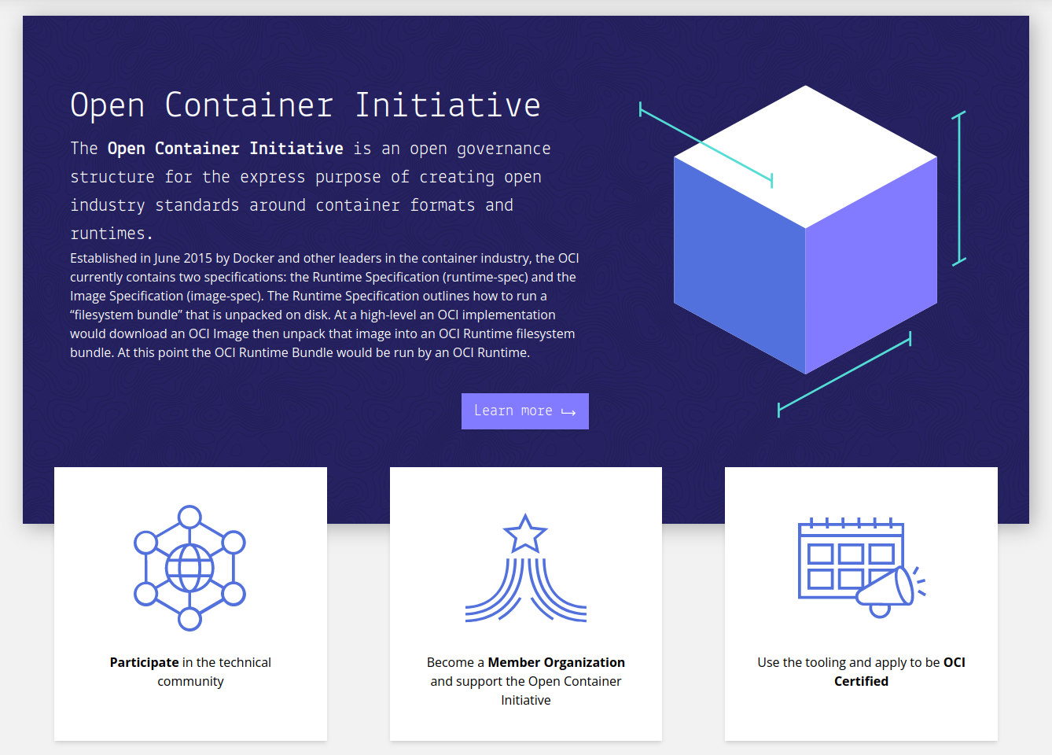
https://opencontainers.org/
Notes:
For any interested parties i recommend looking up opencontainers.org

Slide 9
So, what is docker not?
Docker is not a VM
Applications
Runtimes & Libraries
Runtimes & Libraries
OS
OS
Virtual Hardware
Notes:
The most important thing to impart on you is that containers are not VMs so we need to plan how we build them accordingly and get the results we need with as few moving parts as possible.
With Docker we are removing the headache or overhead of hardware, whether virtualised or bare metal
We also remove the overhead of the OS itself
Docker is JUST the runtimes, libraries and the application you want to run, nothing more nothing less

Slide 10
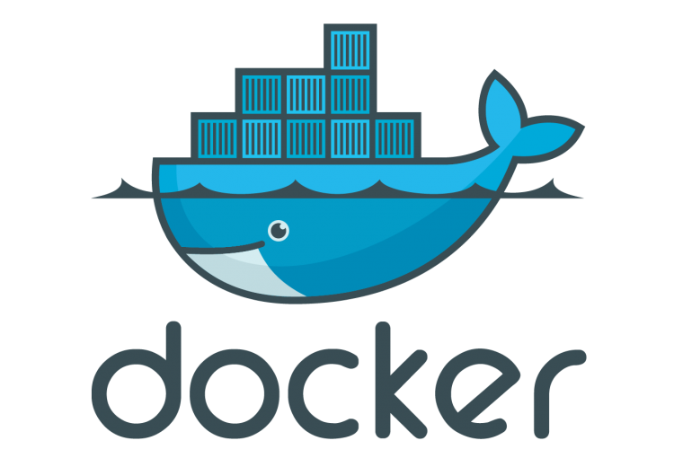
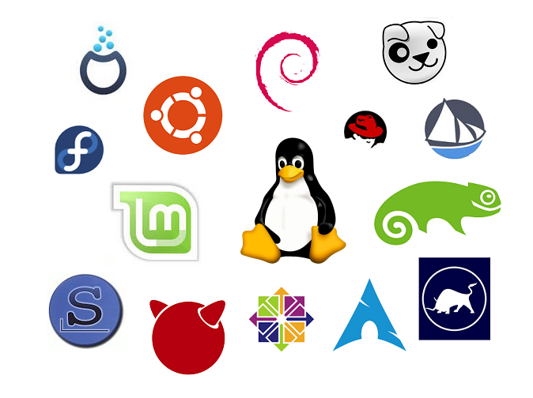
So, what is docker not?
Docker is not a whole OS
…and that’s a good thing
Notes:
So as i mentioned, docker is not an OS in itself, because it is a virtualised OS and actually uses the host OS to communicate with hardware, the docking engine itself contains everything you need to run your applications, including networking, storage etc
Because of its immutable nature (yes its not 100% immutable in container form but the images cannot be changed without rebuilding) it therefore does not degrade in the way an OS would, theres not mandatory security patching, not memory management (its handled by the host and the engine)

Slide 11
So, what is docker not?
Docker is not architecture independent
Notes:
Wait, didn’t i say that docker is “mostly” hardware independant

Slide 13
So, what is docker not?
Docker is not architecture independent
Docker is architecture independent
Docker images are not
…(without some extra steps)
Notes:
Yeah so docker itself will run on most things (not BSD but thats a whole other story)
The images on the other hand are not hardware independant

Slide 14
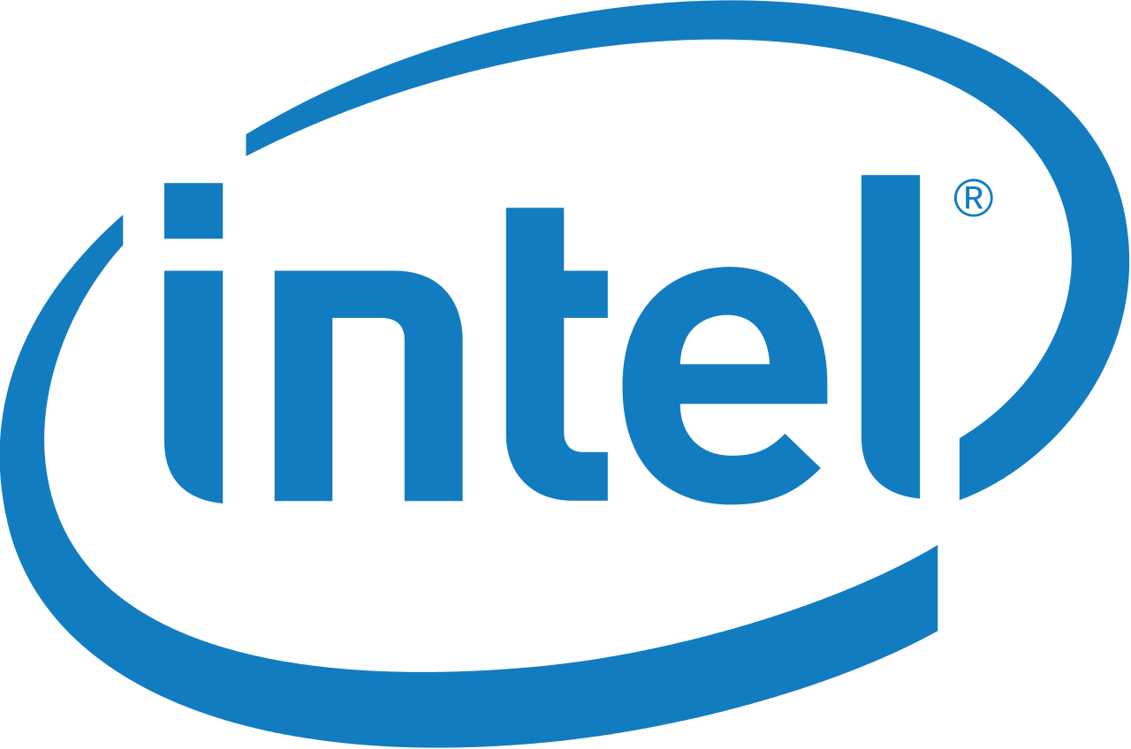
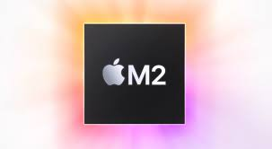

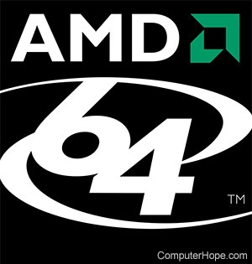
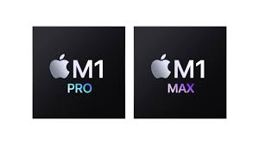
Wait what?
…more on this later
…talk of rosetta will not be tolerated
Notes:
Well you see there are quite a few architectures that can be in modern computers and servers, you have intel and amd in standard x86 hardware, note that for docker itself and most software as you may know x86_64 is usually noted as amd64, doesn’t mean that it will only run on amd chips, they all follow the x86 architecture spec
Then you get newer low powered arm devices or servers, and the new Apple silicon M1 and M2 chips are arm64 architecture
Within these architectures though there are variations, so for most arm chips you would be compiling for arm64v6 or v7, apple chips are v8
A program compiled for x86 architecture will not know how to talk to an arm64 based system and vice versa, now this is not actually 100% true all the time but even if you can get an x86 program to talk to arm, because of the translation going on as a layer in between the result will be horrendously slow, *cough* rosetta *cough*
Proof that just because you “can” do something does not necessarily mean that you should

Slide 15
Dockerfiles
Notes:
lets go through how to properly format a dockerfile before we go any further, i promised the basics so we have a good foundation so lets see what it should look like.

Slide 16
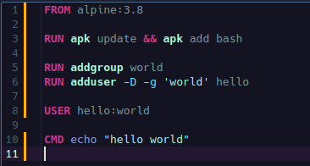
Dockerfile
How to properly construct a dockerfile
Notes:
Now this is a very simple but functional dockerfile it will build but won’t do a great deal
Lets take a look at the valid instructions you can use in a docker file and try to make something a bit more complex

Slide 17


Dockerfile instructions
FROM
ARG
RUN
CMD
Notes:
FROM: A Dockerfile must start with a FROM directive, there are only 2 exceptions to this, globally scoped build arguments denoted by ARG and comments which start with #
FROM can be used multiple times in a build, this can be to build mutiple images, use a build stage as a dependancy for another or more commonly if you name a FROM statement you can then copy binaries from that image.
ARG instructions are build arguments that can be passed to build stage, if an arg is before the FROM it cannot be referenced in the stage as it is outside of the build, you can add the same ARG but without any value to reference the ARG in the build stage.
RUN can be denoted in 2 ways and they are different, you can RUN within a shell by adding RUN followed by a shell command, or you can run it in exec mode by quoting each single part of the string and putting in a comma seperated list in square braces (its json formatted in case you wondered), in shell mode you are running the command directly in the container shell so if you haven't installed bash for instance you cannot run a bash command, with exec you do not invoke a shell directy. very important to note that with the shell form you can span multiple lines if you escape the end of the line with a \
you can also combine RUN with --mount to mount a directory withing the image at build time, valid mounts are bind, tmpfs, ssh, secret. You could use this for say checking out files from GIT into your image when you build them by mounting your ~/.ssh directory
CMD at first glance CMD looks like RUN, you have the exec and shell mode for running commands (you also have a third form for passing parameters) but don't get them mixed up they do very different things. RUN executes at build time on the image you are building, CMD on the other hand runs on container execution.

Slide 18


Dockerfile instructions
LABEL
EXPOSE
ENV
COPY
Notes:
LABEL adds a label to the metadata of your image, add as many as you like or none, you can add one at a time, all in a single line or spread over multiple lines escaped with \
Label for filtering
EG docker ps --filter "label=com.example.demo" (filter is repeatable)
EXPOSE just tells docker (or the person running the container) that this image when run listens on a specific port/protocol, note that it doesn't publish the port so if you want to access on the specified port you need to expose it with the -p flag in docker run or whatever you use to run
ENV unsurprisingly this is environment variables to be given to the image, these do persist when the container is run, you can inspect any env variables inan image and override them when you run your container with the --env variable
If you don't need the variable to persist once the image is built then you can add to a single command in the RUN instruction or in an ARG instruction
Must be set as `key=value` or `key value` though you can set multiple on a single line
COPY much the same as ADD but for local files, can also be used with --link which makes the COPY independant of its own layer and can be used by ultiple layers in a build

Slide 19



Dockerfile instructions
ADD
ENTRYPOINT
VOLUME
USER
Notes:
ADD, the bigger more powerful brother of COPY, with add you can add in a new file or directory from a local or remote source, can be preceeded with a --chown instruction to change the owner of the resulting file.
ENTRYPOINT specify an executable to run on container start, can be in exec form or shell form
VOLUME creates a mountpoint with the specified name and marks it as a place for holding externally mounted volumes, for instance you might want to have /var/log as a mounted volume so you have these as persistant, then you can mount them in your docker run command
Note with the json formatting if using it the volume must be specified with “ not ‘
If anything changes thedata in a volume mount after it has been declared the changes will be discarded
USER sets the username or UID and optionally group/GID for the rest of the stage, so if you create an nginx user you can make sure all commends folowing are executed as the nginx user

Slide 20




Dockerfile instructions
WORKDIR
STOPSIGNAL
ONBUILD
SHELL
Notes:
WORKDIR this specifies the working directory where all following commands will be run, can be specified multiple times and the last WORKDIR instruction denotes the directory any commands will start in (by default docker will start any commands from /)
STOPSIGNAL sets a system call signal to tell the container to exit, the default is SIGTERM but can be overridden by the --stop-signal flag on docker run
ONBUILD sets an instruction to trigger at a later time, so here you would set something to be executed by a subsequent build, it is largely ignored by the build command but the trigger gets added.
SHELL this is the shell within the container that will run the build with, this is NOT the shell you would use on entry, theres a different option for that

Slide 21
Let’s put that all together…

Slide 22
Running containers

Slide 23
Docker run command
docker run [OPTIONS] image [COMMAND]
Options you will most likely need
Notes:
-d detach/daemonise
-it interactive tty
–rm remove container on exit
-v volume mounts can be combined with –read-only or adding ro to make the mount read only
Paths are absolute on the host
–name easily identify your containers by giving them a name (not gandalf) when combined with networks this can be used to allow containers to speak to each other by the name you give them…. More on that later
-p actually expose a port on the container and connect to a port on the host host:container, running -P will expose the ports you have exposed in the docker file to a random host port
Networking
–net connect to a specific docker network
–link [deprecated] was used to link 2 containers
–link-local-ip link your host IP to the container
A note about SSH agent forwarding
Volume mount ${SSH_AUTH_SOCK}:/ssh-agent then set an env variable SSH_AUTH_SOCK=/ssh-agent
Or
Mount the sshdirectory in your image -v ~/.ssh:/home/user/.ssh:ro
Or theres a compose way which we will get to…

Slide 24
MultiArch builds
This is where is gets fun
Notes:
now who is running on an m1 mac?

Slide 25
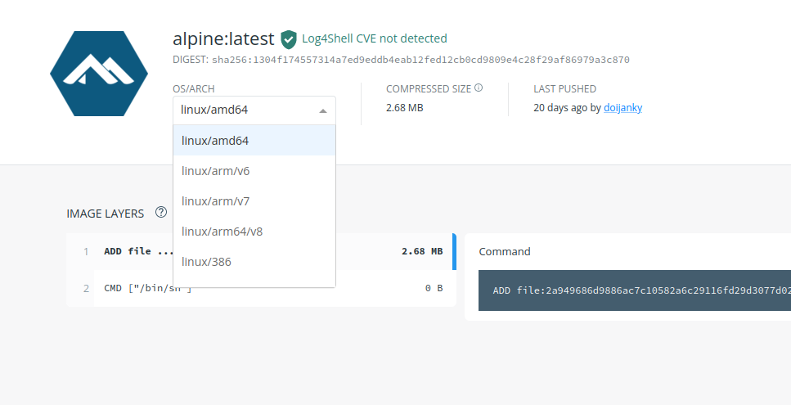
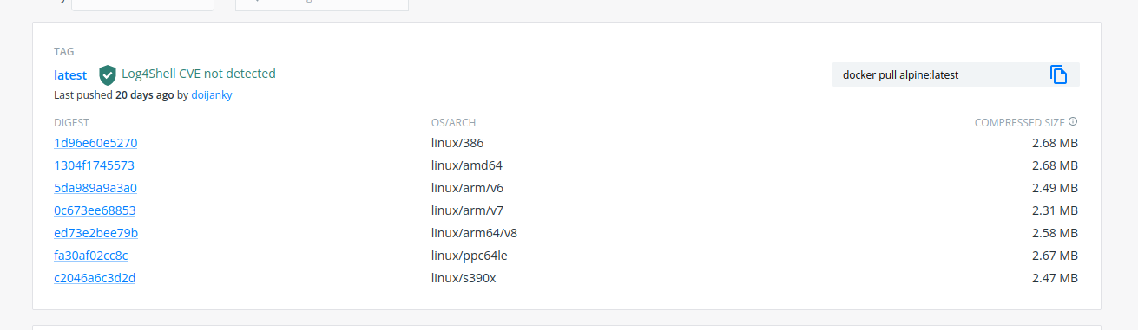
Docker manifests
Notes:
What is a docker manifest and why would we use it?
Examples from docker hub to show single image target with multiple builds
Pick your base image carefully, not everything is compiled for every architecture

Slide 26
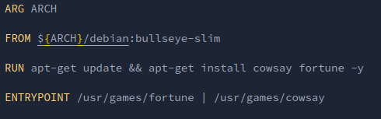
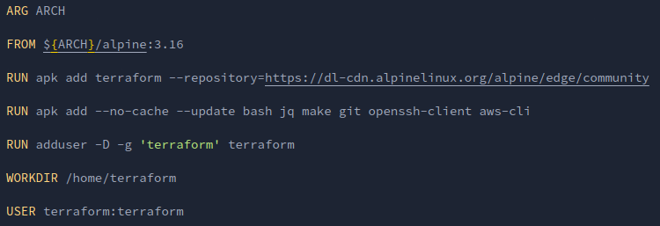
Multiarch builds (the hard way)
Notes:
Built with standard docker, you must specify the architecture of the base images you want to pull, then build and push each separately to your registry.
A manifest must be created and each resultant container must be added to the manifest which is then pushed to the same registry.
When pulling the manifest as a base image or to run you can specify which architecture you use or let your OS arch determine this for you.

Slide 27
Multiarch example
# AMD64
$ docker build -t <your-username>/<your-repo>:manifest-amd64 --build-arg ARCH=amd64 .
$ docker push <your-username>/<your-repo>:manifest-amd64
# ARM64V8
$ docker build -t <your-username>/<your-repo>:manifest-arm64v8 --build-arg ARCH=arm64v8 .
$ docker push <your-username>/<your-repo>:manifest-arm64v8
# Manifest create
$ docker manifest create \
<your-username>/<your-repo>:manifest-latest \
--amend <your-username>/<your-repo>:manifest-amd64 \
--amend <your-username>/<your-repo>:manifest-arm64v8
# Manifest push
$ docker manifest push <your-username>/<your-repo>:manifest-latest

Slide 28
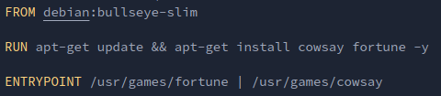
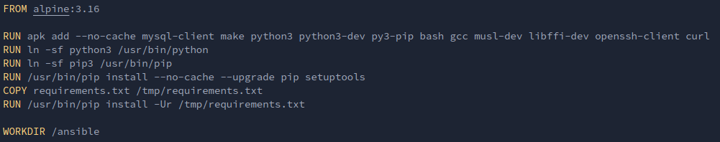
Multiarch builds (the easy way with buildx)
Notes:
Using the buildx docker plugin you can specify the platforms that you will be building for, the build, manifest creation and push to the registry can be done as a one liner.
Note that buildx can be split into multiple instructions as with the docker method to use the standard docker driver, building in one line requires the use of the docker-container driver

Slide 29
Multiarch buildx example
# Setup the buildx environment
docker buildx create --name toolbox
# Tell buildx to use the new environment
docker buildx use toolbox
# The magic oneliner
docker buildx build --push --platform linux/amd64,linux/arm64/v8 -t <your-username>/<your-repo>:buildx-latest .
Notes:
Yadda yadda …. So the easy way or the hard way, simple choice right?

Slide 31
Multiarch buildx - the hard way, but the easier way
# AMD64
docker buildx build --push --platform linux/amd64 \
-t "<your-username>/<your-repo>:buildx-amd64"
# ARM64
docker buildx build --push --platform linux/arm64/v8 \
-t "<your-username>/<your-repo>:buildx-arm64"
# Create and push the manifest
docker manifest create <your-username>/<your-repo>:buildx-latest --amend <your-username>/<your-repo>:buildx-amd64 --amend <your-username>/<your-repo>:buildx-arm64 && \
docker manifest push <your-username>/<your-repo>:buildx-latest

Slide 32
Knowing what we now know about dockerfile and multiarch, let’s build our container better…

Slide 33
Types of containers

Slide 34


Slide 35
The 3 types of containers
Toolbox
Application
Service
Notes:
Now this is not official this is just my opinion, but you can totally trust me, i know what i’m talking about most of the time

Slide 36
Toolbox Containers

Slide 37
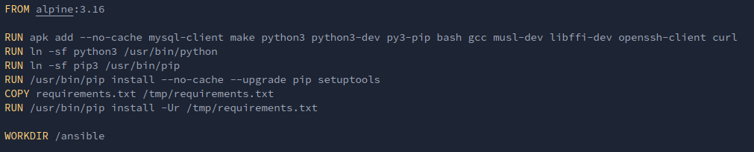
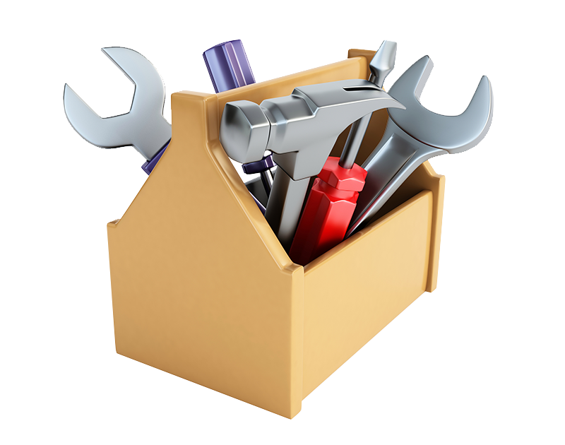
Toolbox containers
Notes:
Single or multi use containers for apps or libraries not necessarily included on the host system.
eg1: build containers containing specific versions of languages
eg2: applications for a deploy job that can be run anywhere

Slide 38
Let's make something useful…

Slide 39
Application Containers

Slide 40
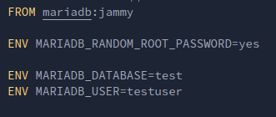
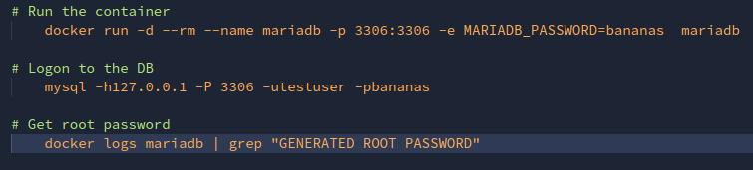
Application containers
Notes:
Your garden variety applications, usually off the shelf, can be pulled directly from the hub rather than rebuilt.
Convenience containers to put it another way.
Size doesn’t matter (much).
Can be stateful.
If you are running long term, this is what you are talking about.

Slide 41
Time to look at running an application…

Slide 42
(Micro)Service Containers

Slide 43
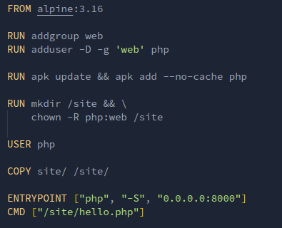
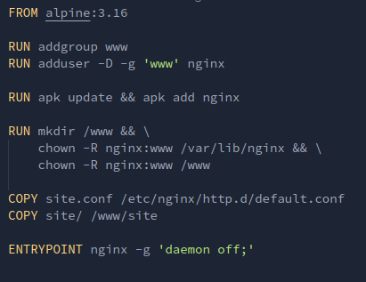
Service containers
Notes:
This is where we get to shine!!!
This is the type of container that as a developer you should be focussing on, just run the application you build, nothing more nothing less.
Should be single purpose, do one thing and do it well.
Small, as small as you can make them, only include what is needed.
Ideally immutable and stateless

Slide 44
Making something small and mighty…

Slide 45
“Compose” yourselves, we’re about to put it all together

Slide 46
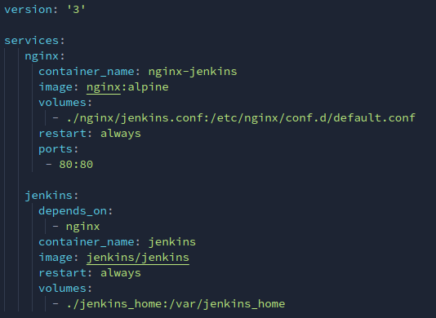
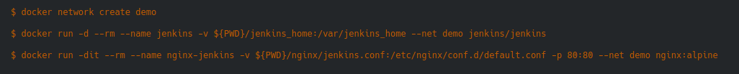
Docker compose - What? Where? Why? And when?
Notes:
What is docker compose?
Where would this come in handy?
Why should we use it?
When should we use it and when not?

Slide 47
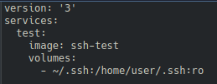
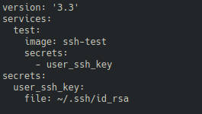
Last word about compose….secrets
/run/secrets/<secret_name>
Notes:
So as i said earlier there is another thing that you can do with docker compose to, say, add an ssh key, you can use secrets!
Now the problem with volume mounts for things like SSH keys is they don’t always work and can be finicky especially in WSL or Mac, there are still ways around this for the determined but docker compose if you are running locally can save you a lot of time and headaches.
Now secrets are not available for standard docker as this is a feature designed for docker swarm but they can be used within docker compose, and since you are likely to be using some kind of orchestration service like swarm or more likely kubernetes or nomad in production it makes sense to learn about secrets and use them in the development process.
So the first way here would be mounting your ssh directory in a container using compose, but if you set up a secrets section and attach that to a service instead then you can find that secret in /run/secrets on the running container, simple right? Then you would just link /run/secrets/user_ssh_key to /home/user/.ssh/id_rsa or whatever.

Slide 48
The end
Thanks for listening

